Slide 1
Chapter 16 JavaFX UI Controls and Multimedia

Slide 2
JavaFX UI Controls
JavaFX provides many UI controls for developing a comprehensive user interface.

Slide 3
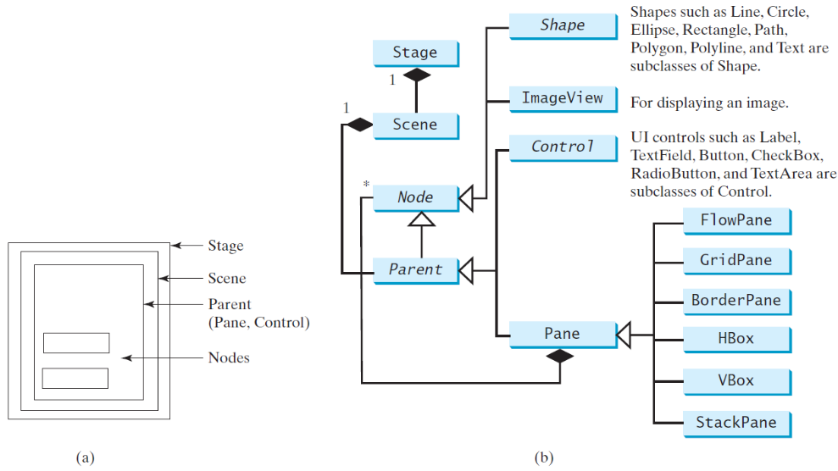
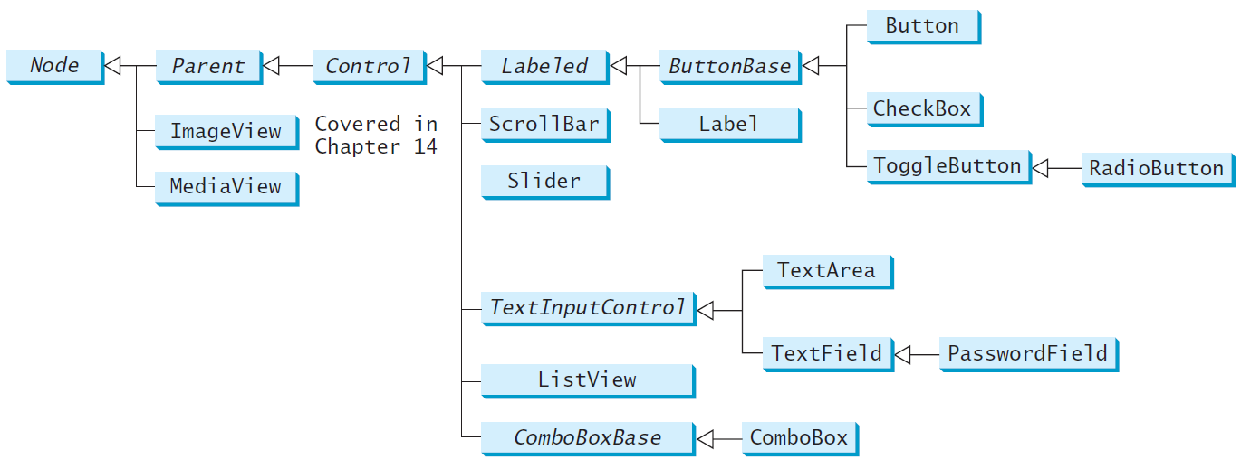
Frequently Used UI Controls

Slide 4

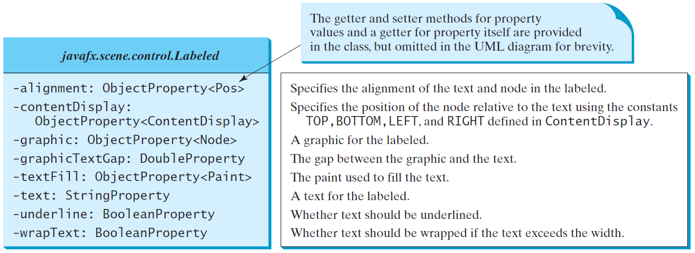
Labeled
A label is a display area for a short text, a node, or both.
It is often used to label other controls (usually text fields).
Labels and buttons share many common properties. These common properties are defined in the Labeled class.

Slide 5

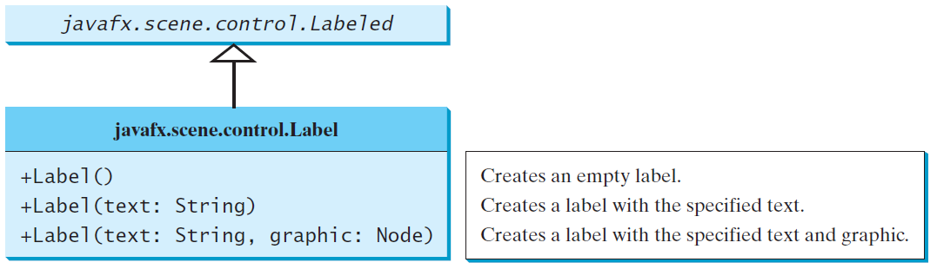
Label
The Label class defines labels.
LabelWithGraphic
Run

Slide 6
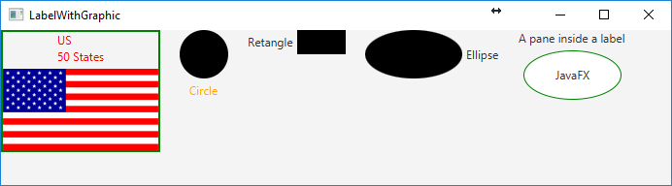
import javafx.application.Application; import javafx.stage.Stage; import javafx.scene.Scene; import javafx.scene.control.ContentDisplay; import javafx.scene.control.Label; import javafx.scene.image.Image; import javafx.scene.image.ImageView; import javafx.scene.layout.HBox; import javafx.scene.layout.StackPane; import javafx.scene.paint.Color; import javafx.scene.shape.Circle; import javafx.scene.shape.Rectangle; import javafx.scene.shape.Ellipse;
public class LabelWithGraphic extends Application { @Override public void start(Stage primaryStage) { ImageView us = new ImageView(new Image("image/us.gif")); Label lb1 = new Label("US\n50 States", us); lb1.setStyle("-fx-border-color: green; -fx-border-width: 2"); lb1.setContentDisplay(ContentDisplay.BOTTOM); lb1.setTextFill(Color.RED); Label lb2 = new Label("Circle", new Circle(50, 50, 25)); lb2.setContentDisplay(ContentDisplay.TOP); lb2.setTextFill(Color.ORANGE); Label lb3 = new Label("Retangle", new Rectangle(10, 10, 50, 25)); lb3.setContentDisplay(ContentDisplay.RIGHT); Label lb4 = new Label("Ellipse", new Ellipse(50, 50, 50, 25)); lb4.setContentDisplay(ContentDisplay.LEFT); 5

Slide 7
Ellipse ellipse = new Ellipse(50, 50, 50, 25); ellipse.setStroke(Color.GREEN); ellipse.setFill(Color.WHITE); StackPane stackPane = new StackPane(); stackPane.getChildren().addAll(ellipse, new Label("JavaFX")); Label lb5 = new Label("A pane inside a label", stackPane); lb5.setContentDisplay(ContentDisplay.BOTTOM); HBox pane = new HBox(20); pane.getChildren().addAll(lb1, lb2, lb3, lb4, lb5); Scene scene = new Scene(pane, 700, 150); primaryStage.setTitle("LabelWithGraphic"); primaryStage.setScene(scene); primaryStage.show(); } public static void main(String[] args) { launch(args); }
}

Slide 8
☑ Check Point
How do you place a text on the right of the node in a label?
Can the text in a label be underlined?
<--- ANSWER --->
Use label.setContentDisplay(ContentDisplay.LEFT).
Yes. Use label.setUnderline(true).

Slide 9

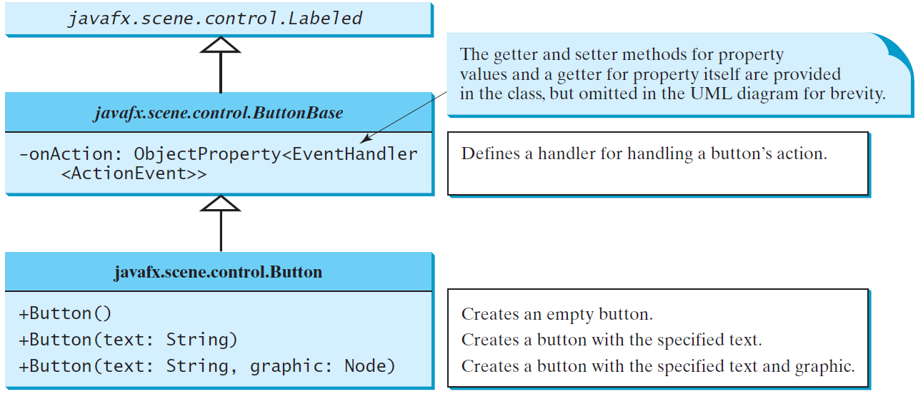
ButtonBase and Button
A button is a control that triggers an action event when clicked.
JavaFX provides regular buttons, toggle buttons, check box buttons, and radio buttons.
The common features of these buttons are defined in ButtonBase and Labeled classes.

Slide 10
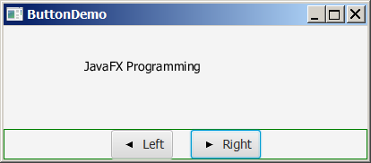
Button Example
ButtonDemo
Run

Slide 11
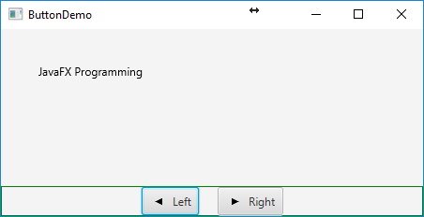
import javafx.application.Application; import javafx.stage.Stage; import javafx.geometry.Pos; import javafx.scene.Scene; import javafx.scene.control.Button; import javafx.scene.image.ImageView; import javafx.scene.layout.BorderPane; import javafx.scene.layout.HBox; import javafx.scene.layout.Pane; import javafx.scene.text.Text;
public class ButtonDemo extends Application { protected Text text = new Text(50, 50, "JavaFX Programming"); protected BorderPane getPane() { HBox paneForButtons = new HBox(20); Button btLeft = new Button("Left", new ImageView("image/left.gif")); Button btRight = new Button("Right", new ImageView("image/right.gif")); paneForButtons.getChildren().addAll(btLeft, btRight); paneForButtons.setAlignment(Pos.CENTER); paneForButtons.setStyle("-fx-border-color: green"); BorderPane pane = new BorderPane();
pane.setBottom(paneForButtons); Pane paneForText = new Pane(); paneForText.getChildren().add(text); pane.setCenter(paneForText);
btLeft.setOnAction(e -> text.setX(text.getX() - 10)); btRight.setOnAction(e -> text.setX(text.getX() + 10));
return pane; }

Slide 12
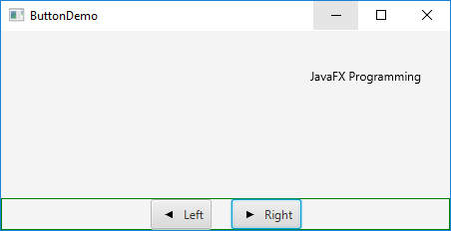
@Override public void start(Stage primaryStage) { Scene scene = new Scene(getPane(), 450, 200); primaryStage.setTitle("ButtonDemo"); primaryStage.setScene(scene); primaryStage.show(); }
public static void main(String[] args) { launch(args); } }

Slide 13
☑ Check Point
How do you create a button with a text and a node? Can you apply all the methods for Labeled to Button?
<--- ANSWER --->
Use the constructor new Button(text, graphic) to create a button with text and node.
You can apply the methods for Labeled in Button, because Button is a subclass of Labeled.

Slide 14

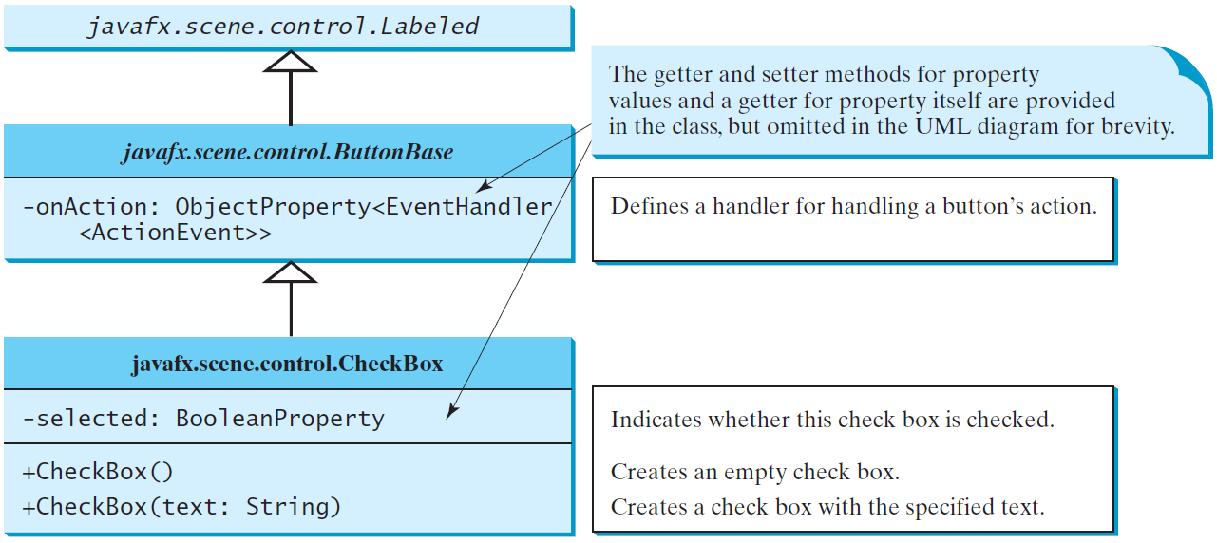
CheckBox
A CheckBox is used for the user to make a selection (square box).
Like Button, CheckBox inherits all the properties such as onAction, text, graphic, alignment, graphicTextGap, textFill, contentDisplay from ButtonBase and Labeled.

Slide 15
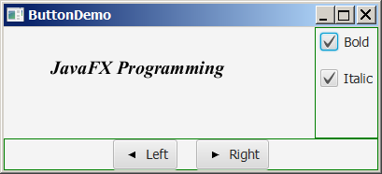
CheckBox Example
CheckBoxDemo
Run

Slide 16
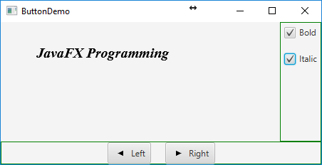
import javafx.event.ActionEvent; import javafx.event.EventHandler; import javafx.geometry.Insets; import javafx.scene.control.CheckBox; import javafx.scene.layout.BorderPane; import javafx.scene.layout.VBox; import javafx.scene.text.Font; import javafx.scene.text.FontPosture; import javafx.scene.text.FontWeight;
public class CheckBoxDemo extends ButtonDemo { @Override // Override the getPane() method in the super class protected BorderPane getPane() { BorderPane pane = super.getPane();
Font fontBoldItalic = Font.font("Times New Roman", FontWeight.BOLD, FontPosture.ITALIC, 20); Font fontBold = Font.font("Times New Roman", Font Weight.BOLD, FontPosture.REGULAR, 20); Font fontItalic = Font.font("Times New Roman", FontWeight.NORMAL, FontPosture.ITALIC, 20); Font fontNormal = Font.font("Times New Roman", FontWeight.NORMAL, FontPosture.REGULAR, 20);
text.setFont(fontNormal);
VBox paneForCheckBoxes = new VBox(20); paneForCheckBoxes.setPadding(new Insets(5, 5, 5, 5)); paneForCheckBoxes.setStyle("-fx-border-color: green"); 11

Slide 17
CheckBox chkBold = new CheckBox("Bold"); CheckBox chkItalic = new CheckBox("Italic"); paneForCheckBoxes.getChildren().addAll(chkBold, chkItalic); pane.setRight(paneForCheckBoxes);
EventHandler<ActionEvent> handler = e -> { if (chkBold.isSelected() && chkItalic.isSelected()) { text.setFont(fontBoldItalic); // Both check boxes checked } else if (chkBold.isSelected()) { text.setFont(fontBold); // The Bold check box checked } else if (chkItalic.isSelected()) { text.setFont(fontItalic); // The Italic check box checked } else { text.setFont(fontNormal); // Both check boxes unchecked } };
chkBold.setOnAction(handler); chkItalic.setOnAction(handler);
return pane; // Return a new pane }
// the start method is inherited from the superclass ButtonDemo public static void main(String[] args) { launch(args); }
}
Notes:
Burada kaldık!

Slide 18
☑ Check Point
What is the output of the following code?
public class Test {
public static void main(String[] args) {
Test test = new Test();
test.new B().start();
}
class A {
public void start() {System.out.println(getP());}
public int getP() {return 1;}
}
class B extends A {
public int getP() {return 2 + super.getP();}
}
}
<--- ANSWER --->
3
Reason: When the start method is invoked from new B(), the getP() method in the B class is invoked. When super.getP() is invoked, the getP() method in the A class is invoked.

Slide 19
☑ Check Point
How do you test if a check box is selected?
Can you apply all the methods for Labeled to CheckBox?
<--- ANSWER --->
Use chk.isSelected().
You can apply all the methods in Labeled to CheckBox, because CheckBox is a subclass of Labeled.

Slide 20
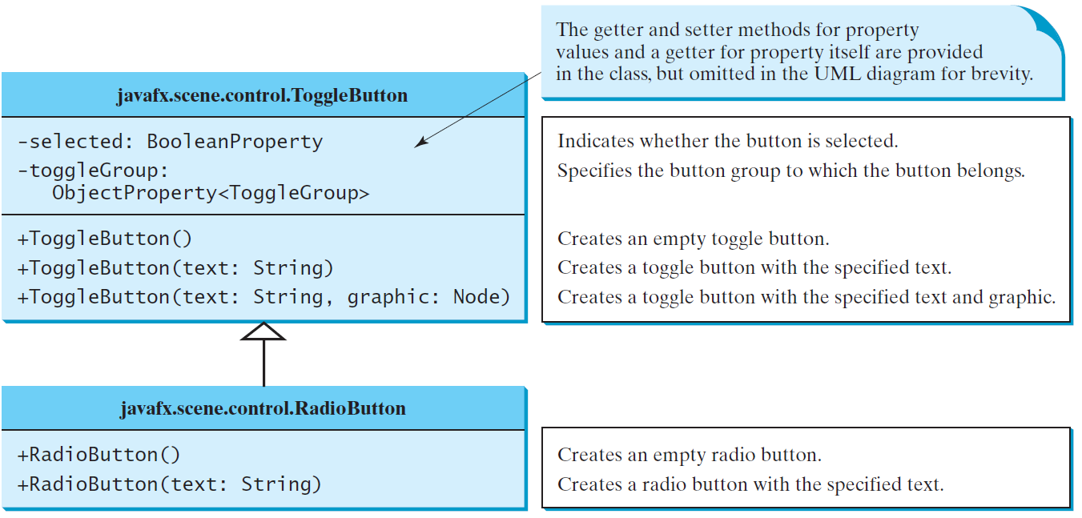
RadioButton
Radio buttons, also known as option buttons, enable you to choose a single item from a group of choices.
In appearance radio buttons resemble check boxes, but check boxes display a square that is either checked or blank, whereas radio buttons display a circle that is either filled (if selected) or blank (if not selected).

Slide 21
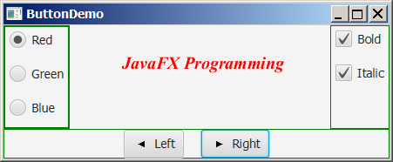
RadioButton Example
RadioButtonDemo
Run

Slide 22
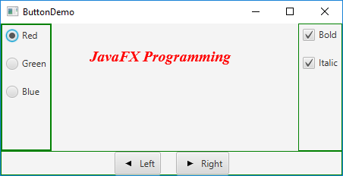
import static javafx.application.Application.launch; import javafx.geometry.Insets; import javafx.scene.control.RadioButton; import javafx.scene.control.ToggleGroup; import javafx.scene.layout.BorderPane; import javafx.scene.layout.VBox; import javafx.scene.paint.Color;
public class RadioButtonDemo extends CheckBoxDemo { @Override // Override the getPane() method in the super class protected BorderPane getPane() { BorderPane pane = super.getPane(); VBox paneForRadioButtons = new VBox(20); paneForRadioButtons.setPadding(new Insets(5, 5, 5, 5)); paneForRadioButtons.setStyle("-fx-border-color: green"); RadioButton rbRed = new RadioButton("Red"); RadioButton rbGreen = new RadioButton("Green"); RadioButton rbBlue = new RadioButton("Blue"); paneForRadioButtons.getChildren().addAll(rbRed, rbGreen, rbBlue); pane.setLeft(paneForRadioButtons); ToggleGroup group = new ToggleGroup(); rbRed.setToggleGroup(group); rbGreen.setToggleGroup(group); rbBlue.setToggleGroup(group);
rbRed.setOnAction(e -> {
if (rbRed.isSelected()) { text.setFill(Color.RED); } 14 });

Slide 23
rbGreen.setOnAction(e -> { if (rbGreen.isSelected()) { text.setFill(Color.GREEN); } });
rbBlue.setOnAction(e -> { if (rbBlue.isSelected()) { text.setFill(Color.BLUE); } });
return pane; } // the start method is inherited from the superclass ButtonDemo public static void main(String[] args) { launch(args); } }

Slide 24
☑ Check Point
How do you test if a radio button is selected?
How do you group radio buttons?
<--- ANSWER --->
Use rb.isSelected().
Create a ToggleGroup tg and set radio button’s toggleGroup property to tg.

Slide 25
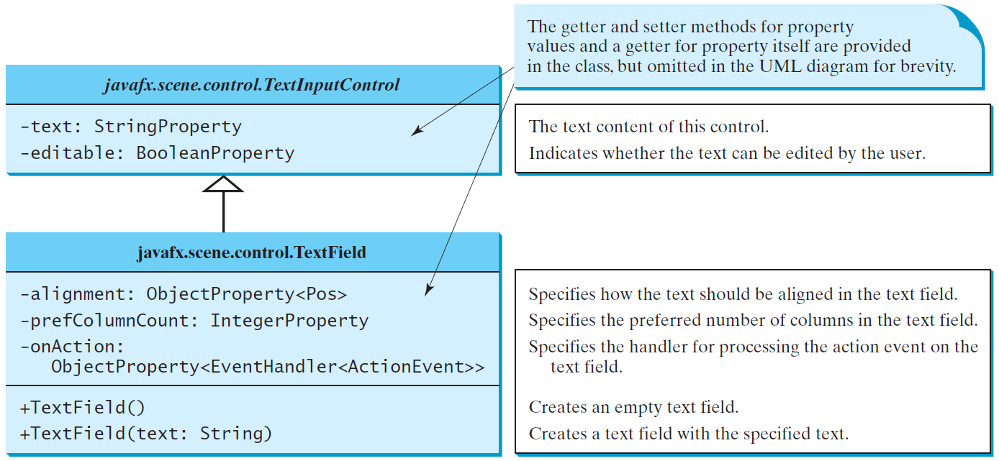
TextField
A text field can be used to enter or display a string. TextField is a subclass of TextInputControl.

Slide 26
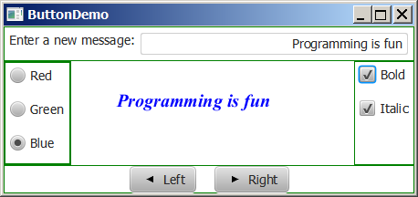
TextField Example
TextFieldDemo
Run

Slide 27
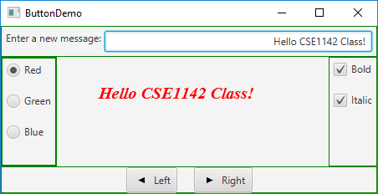
import static javafx.application.Application.launch; import javafx.geometry.Insets; import javafx.geometry.Pos; import javafx.scene.control.Label; import javafx.scene.control.TextField; import javafx.scene.layout.BorderPane;
public class TextFieldDemo extends RadioButtonDemo{ @Override protected BorderPane getPane() { BorderPane pane = super.getPane(); BorderPane paneForTextField = new BorderPane(); paneForTextField.setPadding(new Insets(5, 5, 5, 5)); paneForTextField.setStyle("-fx-border-color: green"); paneForTextField.setLeft(new Label("Enter a new message: ")); TextField tf = new TextField(); tf.setAlignment(Pos.BOTTOM_RIGHT); paneForTextField.setCenter(tf); pane.setTop(paneForTextField); tf.setOnAction(e -> text.setText(tf.getText()));
return pane; } public static void main(String[] args) { launch(args); }
}

Slide 28
☑ Check Point
Can you disable editing of a text field?
Can you apply all the methods for TextInputControl to TextField?
Can you set a node as the graphic property in a text field?
How do you align the text in a text field to the right?
<--- ANSWER --->
Yes. Use tf.setEditable(false).
You can apply all the methods in TextInputControl to TextField, because TextField is a subclass of TextInputControl.
No.
Use tf.setAlignment(Pos.BASELINE_RIGHT).

Slide 29
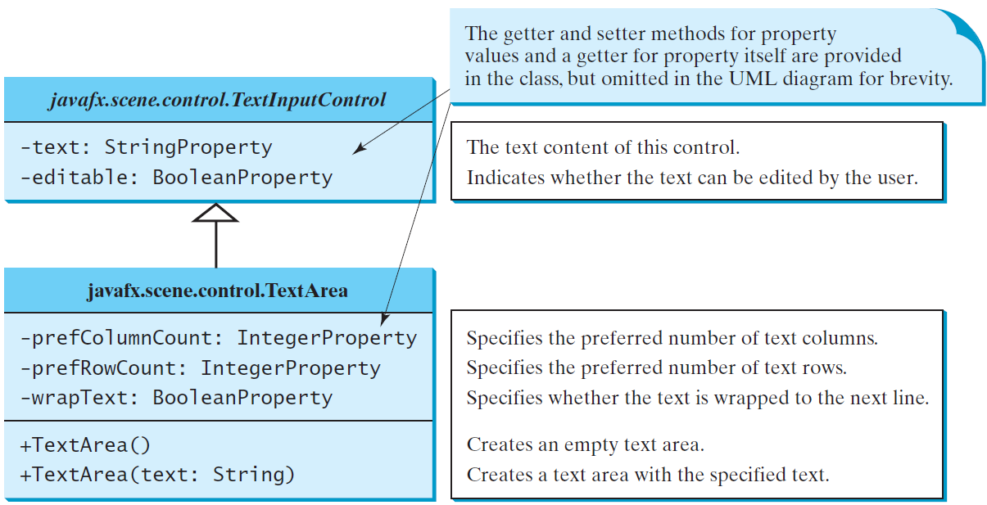
TextArea
A TextArea enables the user to enter multiple lines of text.

Slide 30
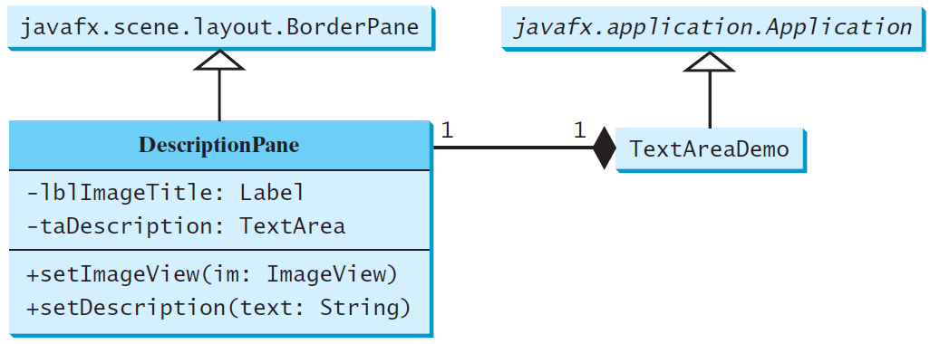
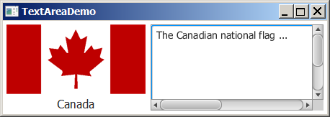
TextArea Example
A TextArea enables the user to enter multiple lines of text.
DescriptionPane
TextAreaDemo
Run

Slide 31
☑ Check Point
How do you create a text area with 10 rows and 20 columns?
How do you obtain the text from a text area?
Can you disable editing of a text area?
What method do you use to wrap text to the next line in a text area?
<--- ANSWER --->
Create a TextArea using new TextArea and then set its prefRowCount to 10 and prefColumnCount to 20.
Use ta.getText().
Yes. Use ta.setEditable(false).
Use ta.setWrapText(true).

Slide 32
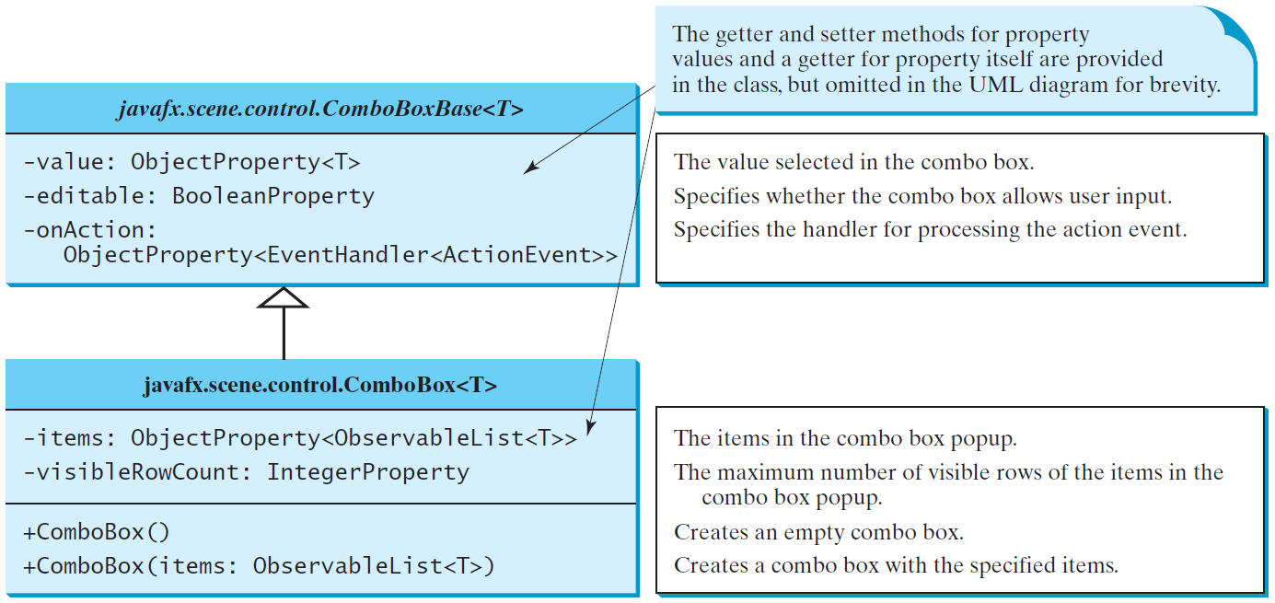
ComboBox
A combo box, also known as a choice list or drop-down list, contains a list of items from which the user can choose.

Slide 33
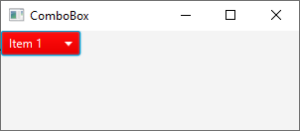

//import statements
public class TestComboBox extends Application {
public void start(Stage primaryStage) {
ComboBox<String> cbo = new ComboBox<>();
cbo.getItems().addAll("Item 1", "Item 2", "Item 3", "Item 4");
cbo.setStyle("-fx-color: red");
cbo.setValue("Item 1");
Label selected = new Label("");
EventHandler<ActionEvent> event = new EventHandler<ActionEvent>() {
public void handle(ActionEvent e) {
selected.setText(cbo.getValue() + " selected");
}
};
cbo.setOnAction(event);
HBox h = new HBox();
h.getChildren().add(cbo);
HBox h2 = new HBox();
h2.getChildren().add(selected);
BorderPane p = new BorderPane();
p.setTop(h);
p.setCenter(h2);
Scene scene = new Scene(p, 300, 100);
primaryStage.setTitle("ComboBox"); // Set the stage title
primaryStage.setScene(scene); // Place the scene in the stage
primaryStage.show(); // Display the stage
}
public static void main(String[] args) {
launch(args);
}
}

Slide 34
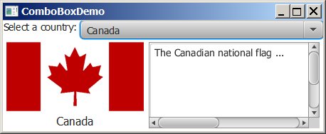
ComboBox Example
This example lets users view an image and a description of a country's flag by selecting the country from a combo box.
ComboBoxDemo
Run

Slide 35
☑ Check Point
How do you create a combo box and add three items to it?
How do you retrieve an item from a combo box? How do you retrieve a selected item from a combo box?
How do you get the number of items in a combo box? How do you retrieve an item at a specified index in a combo box?
What events would a ComboBox fire upon selecting a new item?
<--- ANSWER --->
Use new ComboBox<>(). Use cbo.getItems().addAll(item1, item2, item3).
Use cbo.getItems() to return a list of values in the combo box. Use cbo.getValue() to get selected value.
Use cbo.getItems().size() to return the number of items in a combo box and use cbo.getItems().get(i) to get the item at the specified index in a combo box.
Upon selecting a new item, a combo box fires an ActionEvent.

Slide 36
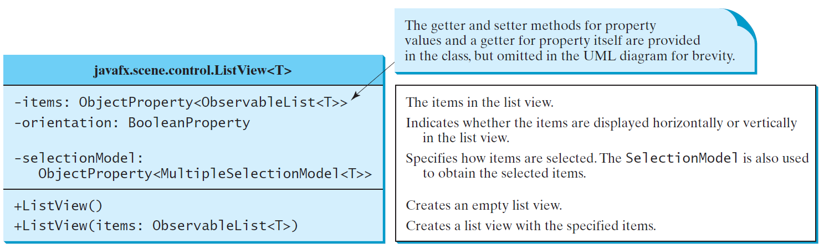
ListView
A list view is a component that performs basically the same function as a combo box, but it enables the user to choose a single value or multiple values.

Slide 37
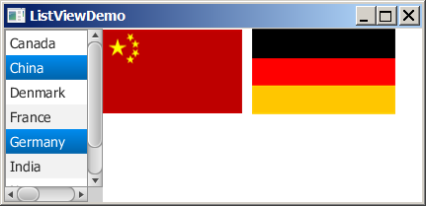
Example: Using ListView
This example gives a program that lets users select countries in a list and display the flags of the selected countries in the labels.
ListViewDemo
Run

Slide 38
// import statements…
public class ListViewDemo extends Application { // Declare an array of Strings for flag titles private String[] flagTitles = {"United States of America", "Canada", "China", "Denmark", "France", "Germany", "India"}; // Declare an ImageView array for the national flags private ImageView[] ImageViews = { new ImageView("image/us.gif"), new ImageView("image/ca.gif"), new ImageView("image/china.gif"), new ImageView("image/denmark.gif"), new ImageView("image/fr.gif"), new ImageView("image/germany.gif"), new ImageView("image/india.gif") }; @Override public void start(Stage primaryStage) { ListView<String> lv = new ListView<>(FXCollections .observableArrayList(flagTitles)); 21 lv.setPrefSize(400, 400);
lv.getSelectionModel().setSelectionMode(SelectionMode.MULTIPLE);

Slide 39
// Create a pane to hold image views FlowPane imagePane = new FlowPane(10, 10); BorderPane pane = new BorderPane(); pane.setLeft(new ScrollPane(lv)); pane.setCenter(imagePane);
lv.getSelectionModel().selectedItemProperty().addListener( ov -> { imagePane.getChildren().clear(); for (Integer i: lv.getSelectionModel().getSelectedIndices()) { imagePane.getChildren().add(ImageViews[i]); } });
Scene scene = new Scene(pane, 450, 170); primaryStage.setTitle("ListViewDemo"); primaryStage.setScene(scene); primaryStage.show(); } public static void main(String[] args) { launch(args); } }

Slide 40
☑ Check Point
How do you create an observable list with an array of strings?
What selection modes are available for a list view? What is the default selection mode? How do you set a selection mode?
How do you obtain the selected items and selected indices?
<--- ANSWER --->
To create an observable list with an array of strings, use FXCollections.observableArrayList(arrayOfStrings);
Two selection modes can be used in a list view: SelectionMode.MULTIPLE and SelectionMode.SINGLE. To set a selection mode, use lv.getSelectionModel().setSelectionMode(SelectionMode.MULTIPLE).
Use lv.getSelectionModel().getSelectedItems() and lv.getSelectionModel().getSelectedIndices().

Slide 41
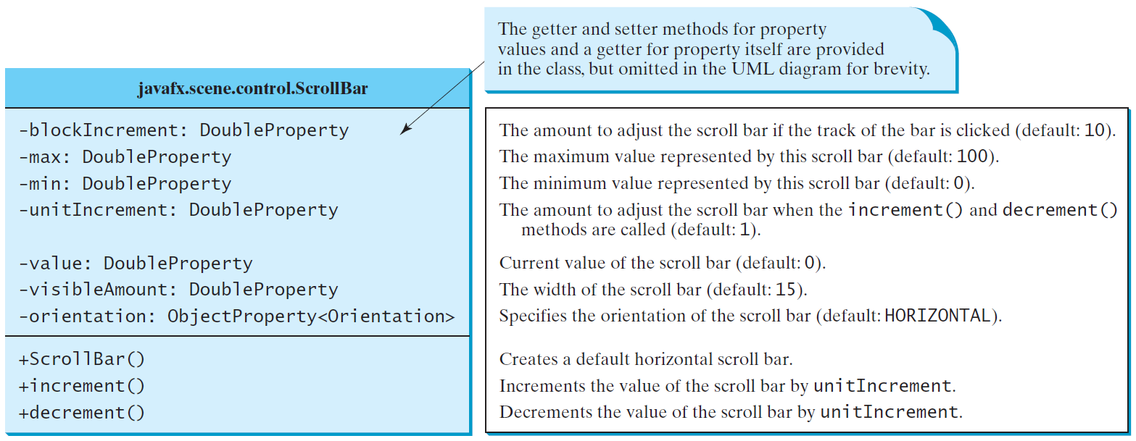
ScrollBar
A scroll bar is a control that enables the user to select from a range of values. The scrollbar appears in two styles: horizontal and vertical.

Slide 42
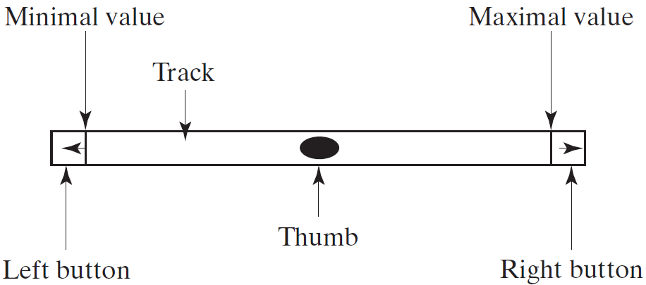
Scroll Bar Properties

Slide 43
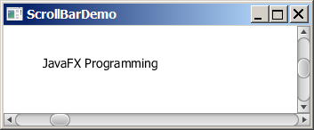
Example: Using Scrollbars
This example uses horizontal and vertical scrollbars to control a message displayed on a panel. The horizontal scrollbar is used to move the message to the left or the right, and the vertical scrollbar to move it up and down.
ScrollBarDemo
Run

Slide 44
☑ Check Point
How do you create a horizontal scroll bar? How do you create a vertical scroll bar?
How do you write the code to respond to the value property change of a scroll bar?
<--- ANSWER --->
To create a horizontal scroll bar, create a ScrollBar using new ScrollBar() and then invoke its setOrientation(Orientation.HORIZONTAL) or setOrientation(Orientation.VERTICAL).
Use sb.valueProperty().addListener(ov -> statements) to respond to a change in the scroll bar value.

Slide 45
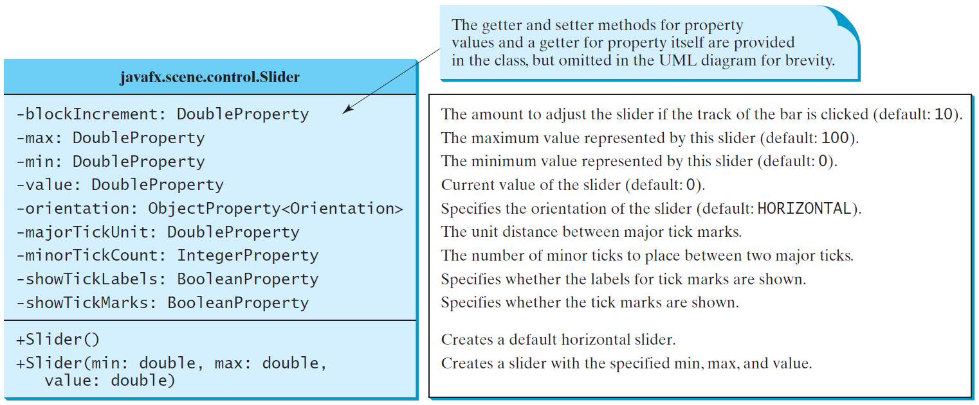
Slider
Slider is similar to ScrollBar, but Slider has more properties and can appear in many forms.

Slide 46
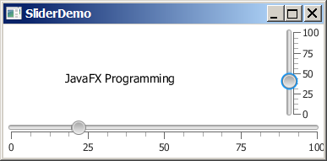
Example: Using Sliders
Rewrite the preceding program using the sliders to control a message displayed on a panel instead of using scroll bars.
SliderDemo
Run

Slide 47
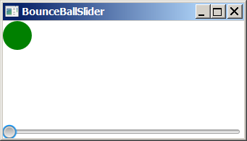
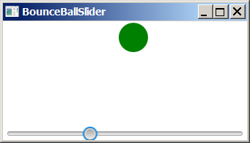
Case Study: Bounce Ball
Listing 15.17 gives a program that displays a bouncing ball. You can add a slider to control the speed of the ball movement.
Bounce Ball Slider
Run

Slide 48
☑ Check Point
How do you add a listener to handle the property value change of a slider?
How do you get the value from a slider? How do you get the maximum value from a slider?
<--- ANSWER --->
Use sl.valueProperty().addListener(ov -> statements) to respond to a change in the slider value.
To get the value from a slider, use sl.getValue(). To get the scroll bar's maximum value, use sl.getMax().

Slide 49
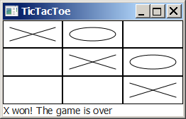
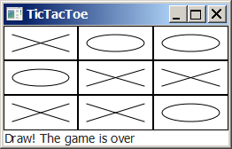
Case Study: TicTacToe

Slide 50
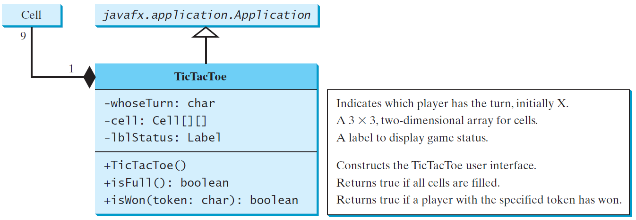
Case Study: TicTacToe, cont.
TicTacToe
Run

Slide 51
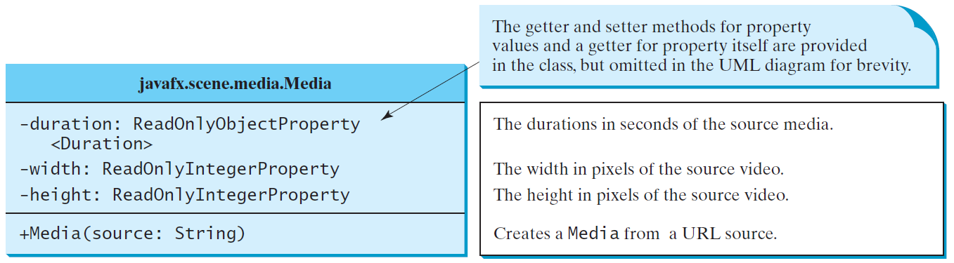
Media
The Media class is used to obtain the source of the media.
The MediaPlayer class is used to play and control the media.
The MediaView class is used to display the video.

Slide 52
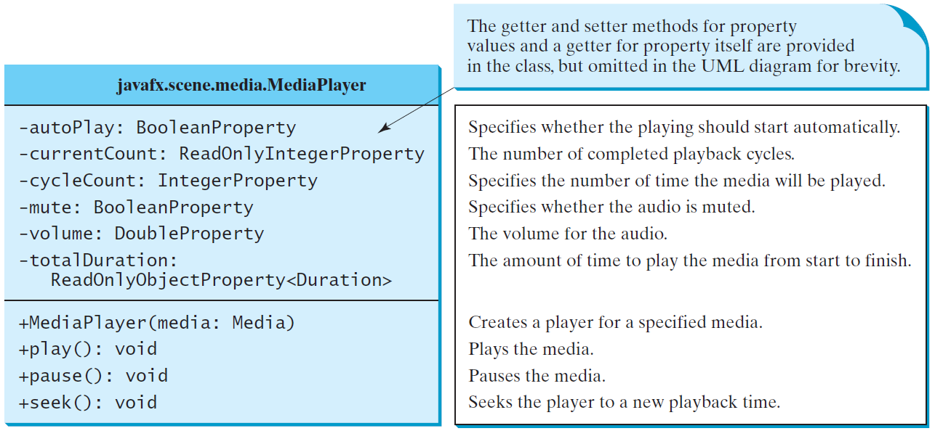
MediaPlayer
The MediaPlayer class playes and controls the media with properties such as autoPlay, currentCount, cycleCount, mute, volume, and totalDuration.

Slide 53
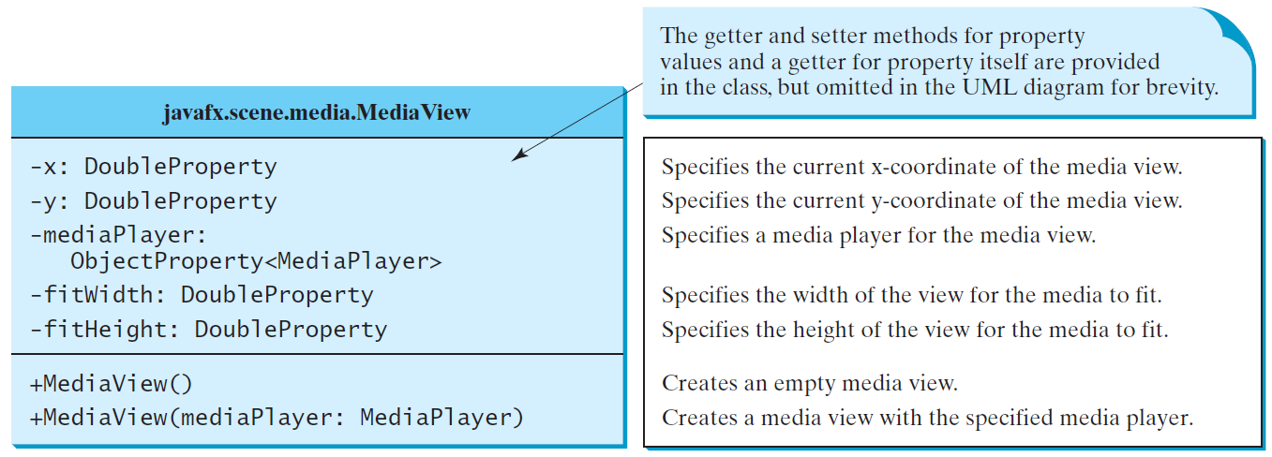
MediaView
The MediaView class is a subclass of Node that provides a view of the Media being played by a MediaPlayer. The MediaView class provides the properties for viewing the media.

Slide 54
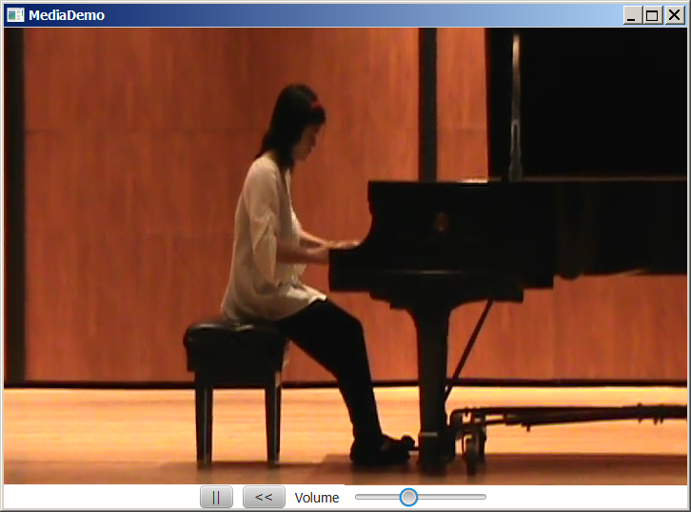
Example: Using Media
This example displays a video in a view. You can use the play/pause button to play or pause the video and use the rewind button to restart the video, and use the slider to control the volume of the audio.
MediaDemo
Run

Slide 55
☑ Check Point
Can you place a Media in multiple MediaPlayers? Can you place a MediaPlayer in multiple MediaViews? Can you place a MediaView in multiple Panes?
<--- ANSWER --->
You can place a Media in multiple MediaPlayer and a MediaPlayer in multiple MediaView, but cannot place a MediaView in multiple panes.

Slide 56
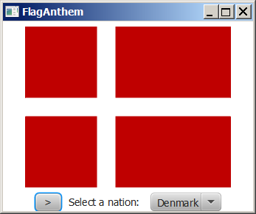
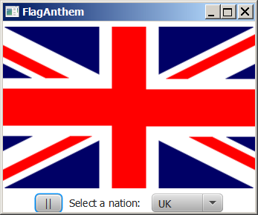
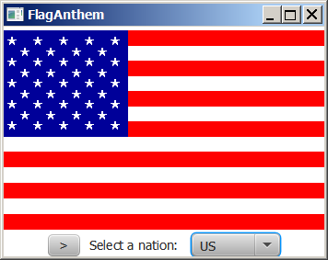
Case Study: National Flags and Anthems
This case study presents a program that displays a nation’s flag and plays its anthem.
FlagAnthem
Run

